Slide 1
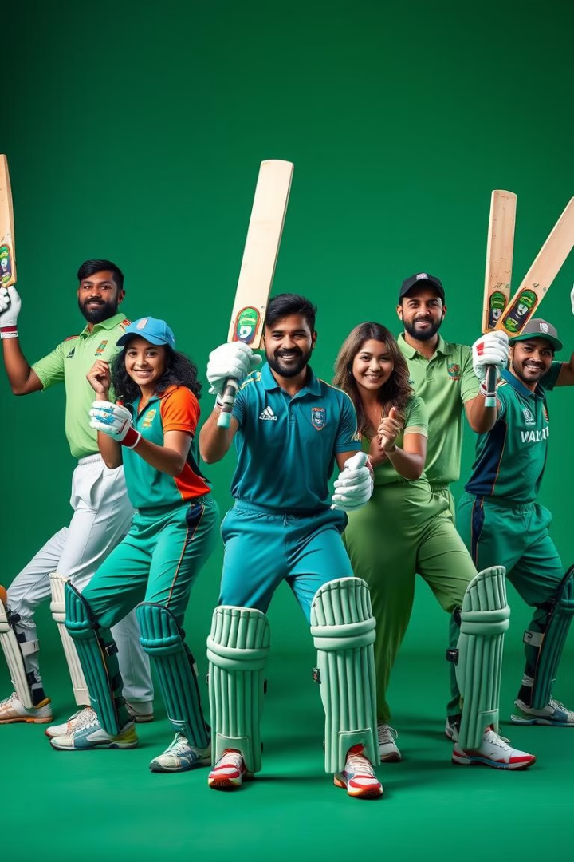
The Ultimate T20 Cricket Team
This project aims to construct the ultimate T20 cricket team by leveraging data from the 2019 to 2024 World Cups and t20s . Using web scraping, data cleaning, and rigorous analysis, we’ll identify the top performers and assemble a dream team.

Slide 2
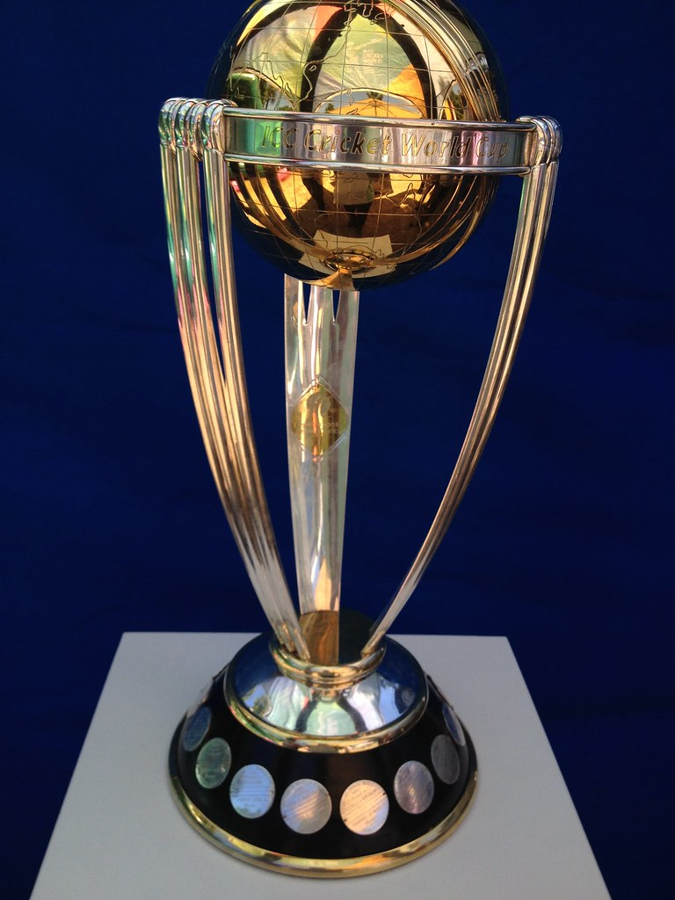
Problem statement
Selecting the most optimal T20 cricket team is challenging due to the vast amount of player performance data.
Key Issues:
Inconsistent performance across different match conditions
Balancing roles: Batsmen, bowlers, and allrounders for team effectiveness
Subjective selection: Need for objective, data driven criteria to minimize bias
Goal:
Use data analysis to create a balanced and highperforming T20 team based on 2022 and 2024 World Cup data.

Slide 3


Project overview
Objective:
To use data analysis techniques to select the ultimate T20 cricket team based on player performances in the 2020 to 2024 all World Cups and IPL.
Data Sources:
Match data from 2020 to 2024 all World Cups and IPL
Player performance statistics (batting, bowling, allrounder contributions)
Methods Used:
Web Scraping: Extracted match and player data using Beautiful Soup
Data Cleaning: Processed raw data to handle inconsistencies and missing values
Analysis: Established criteria to rank and select topperforming players
Outcome:
A data-driven selection of the best cricket team, balancing key roles like batsmen, bowlers, and all-rounders.

Slide 4

Data Collection: Web Scraping with Beautiful Soup
1
Web Scraping
2
Data Sources
We utilized Beautiful Soup to extract relevant match data from official websites, such as ESPNcricinfo.
Collected data included player statistics, each player details , team scores, match details, and other key metrics.
3
Structured Data
4
Comprehensive Data
The extracted data was structured into a format suitable for data cleaning and analysis.
The data collected encompassed both the 2022 and 2024 World Cups, ensuring a robust dataset for analysis.

Slide 5
Data Cleaning and Preprocessing
Handling Missing
and Null Values
Removing Players with
Zero Performance
Standardizing Data
All null values for player statistics (e.g., runs, wickets, strike rate) were filled with 0 to maintain data integrity.
Batsmen with a strike rate (SR) of 0 were removed from the dataset, as they did not contribute meaningfully to their teams..
Ensured that metrics like strike rates, averages, and economy rates were calculated and formatted consistently across all players.
Dealing with Outliers:
New Metrics
Final Cleaned Dataset
High or low strike rates, economy rates, or wickets taken were reviewed manually.
A combined measure of batting, bowling, and all-round performance to assess a player's overall contribution.
A fully preprocessed dataset with no null values, standardized formats, and non-performers removed, ready for detailed performance analysis.

Slide 6
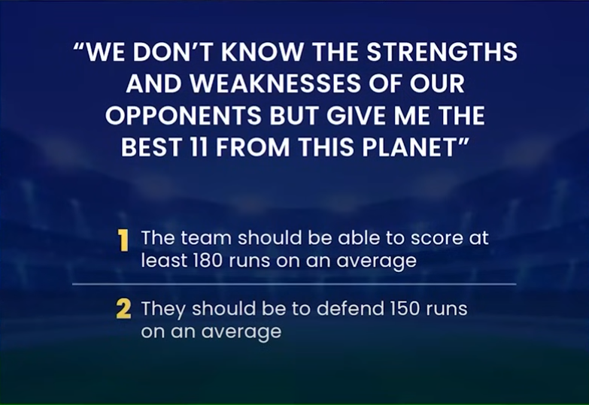
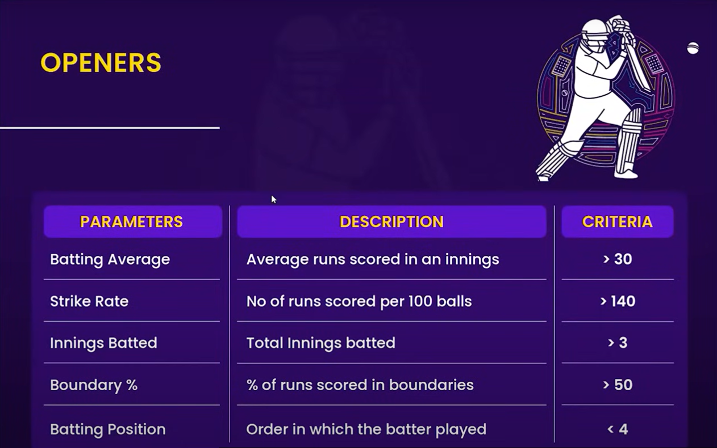
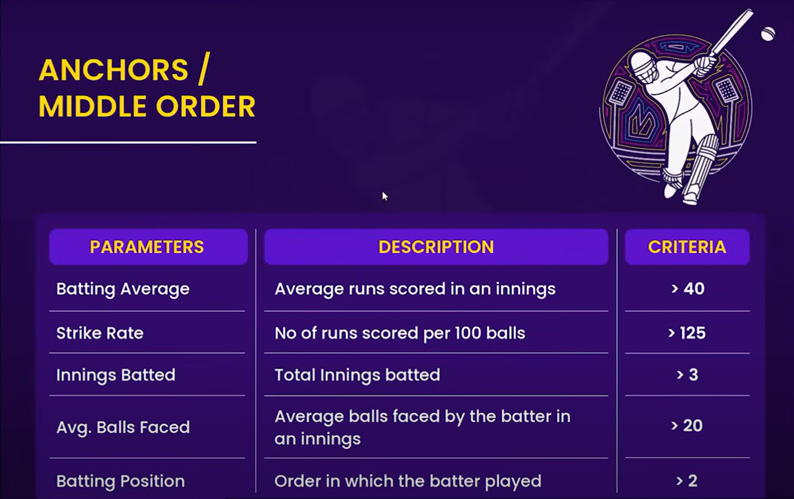
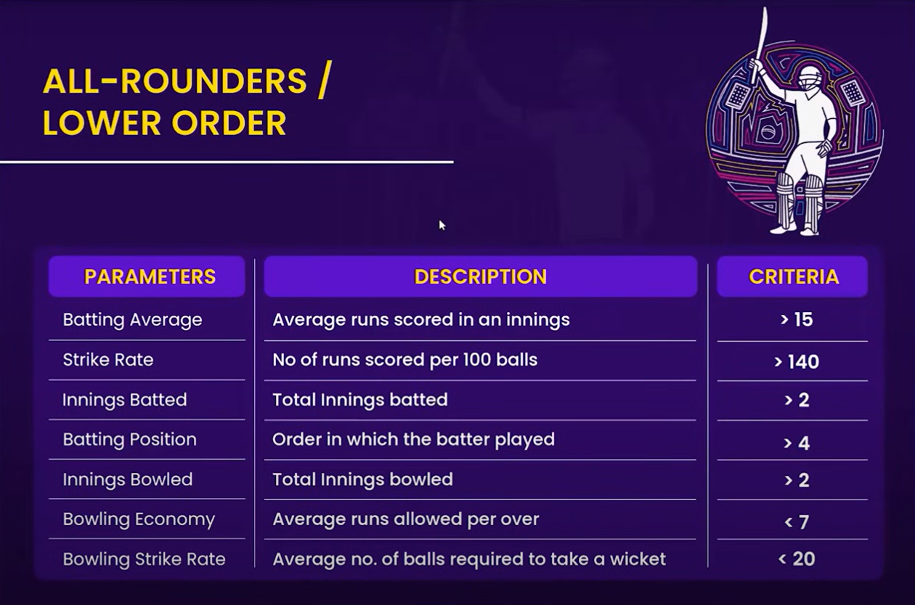
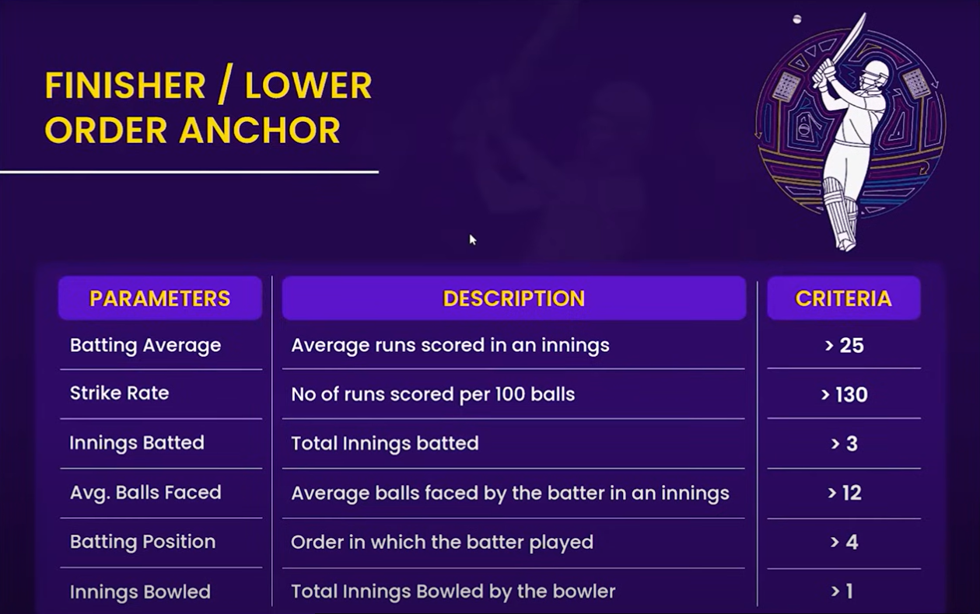
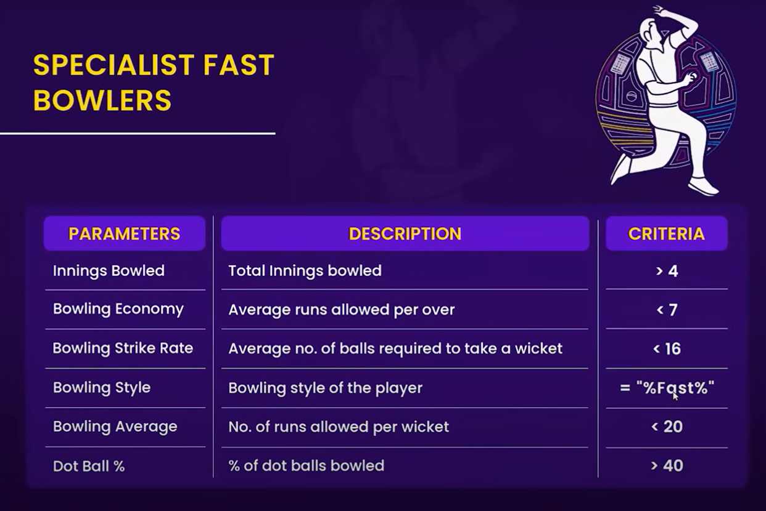
Criteria for Player Selection

Slide 7

List of tournaments for the analysis
Sno | match | year
1 | t20 | 2020
2 | t20 | 2022
3 | t20 | 2024
4 | ipl | 2024
5 | ipl | 2023
6 | ipl | 2022
7 | ipl | 2021
8 | ipl | 2020
9 | odi | 2024
10 | odi | 2019

Slide 8
Final Selected players
Player Name | Country | Role
Glenn Maxwell | Australia | Batting Allrounder
Jos Buttler | England | Wicketkeeper Batter
Arshdeep Singh | India | Bowler
David Warner | Australia | Opening Batter
Suryakumar Yadav | India | Batter
Heinrich Klaasen | South Africa | Wicketkeeper Batter
Glenn Phillips | New Zealand | Allrounder
Virat Kohli | India | Top order Batter
Marcus Stoinis | Australia | Batting Allrounder
Taskin Ahmed | Bangladesh | Bowler
Jasprit Bumrah | India | Bowler
Travis Head | Australia | Batter

Slide 9
Selected batsman stats
SNO. | batsmanName | Total_Innings_Batted | Total_Runs | Average_SR | Avg_Boundary_Percentage | Avg_Batting_Average
0 | David Warner | 30.0 | 1256.0 | 124.000602 | 60.686703 | 41.974026
1 | Glenn Maxwell | 60.0 | 1791.0 | 145.685786 | 60.195534 | 30.102515
2 | Glenn Phillips | 16.0 | 544.0 | 124.623148 | 59.993066 | 33.622222
3 | Heinrich Klaasen | 10.0 | 373.0 | 123.195000 | 51.179057 | 37.300000
4 | Jos Buttler | 17.0 | 863.0 | 128.744118 | 60.396760 | 50.764706
5 | Marcus Stoinis | 14.0 | 382.0 | 138.954167 | 54.491348 | 27.566667
6 | Suryakumar Yadav | 29.0 | 1104.0 | 158.564278 | 59.987820 | 38.391667
7 | Travis Head | 13.0 | 584.0 | 120.003571 | 71.226581 | 45.630952
8 | Virat Kohli | 32.0 | 1563.0 | 137.169848 | 53.269785 | 48.850505
Selected bowler stats
Sno. | bowlerName | Total_Inning_Bowled | Avg_Bowling_Economy | Avg_Bowling_Strike | Avg_Bowling_Avg | Avg_Dot_Ball_Percentage
0 | Arshdeep Singh | 28.0 | 8.276667 | 12.563333 | 18.023333 | 45.480000
1 | Glenn Maxwell | 39.0 | 7.082000 | 16.712000 | 16.516000 | 37.998000
2 | Glenn Phillips | 11.0 | 7.355000 | 6.835000 | 5.640000 | 36.200000
3 | Jasprit Bumrah | 42.0 | 6.810000 | 13.436667 | 14.806667 | 46.900000
4 | Marcus Stoinis | 16.0 | 8.156667 | 13.500000 | 18.880000 | 32.876667
5 | Taskin Ahmed | 16.0 | 7.343333 | 13.483333 | 17.176667 | 56.543333
6 | Travis Head | 5.0 | 4.460000 | 15.000000 | 10.500000 | 49.560000

Slide 10
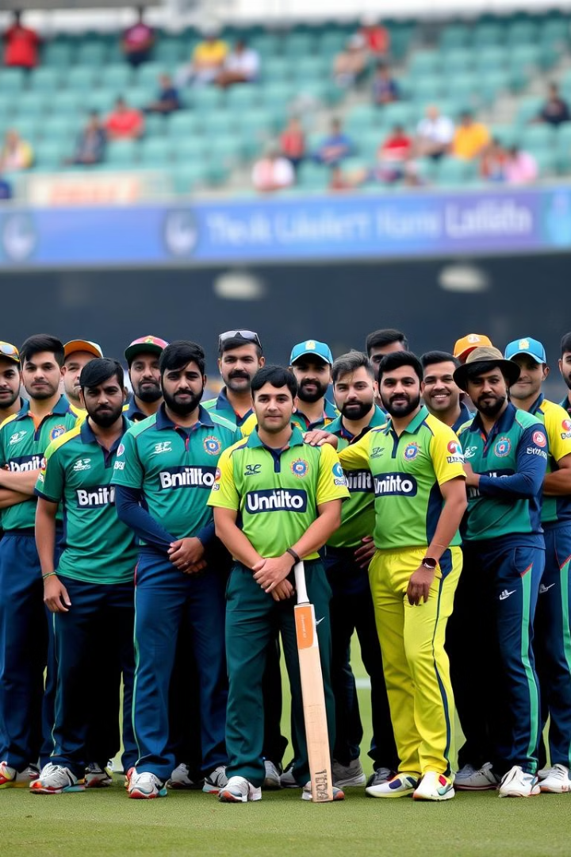



Final Team Composition
Balanced Team
The final team was carefully selected to achieve a balance between batting, bowling, and all-round skills.
Strategic Selection
Player roles and positions were considered to create a well-rounded and dynamic team.
Team Composition
We chose a combination of experienced and emerging players to maximize team potential.

Slide 11




Results, Evaluation, and Future Directions
Team Performance
The team’s performance was evaluated based on its overall win-loss record and individual player contributions.
Data Analysis
Ongoing data analysis will be conducted to identify areas for improvement and optimize team performance.
Future Research
Future research will explore incorporating real-time data and advanced analytics to enhance team selection and performance.

